Slide 1
Introduction to Web Engineering
Lecturer Nisar Ahmed Siddiqui
Sukkur IBA University

Slide 2
Course Information
Course code: CSC-325
Pre-requisite: CSC-121 (Introduction to Programming)
Languages: CSS, HTML, and JavaScript (MySQL & MongoDB)
Code Editors: sublime text, brackets, dream weaver and any other
Installing WAMP/XAMPP would suffice for the work of development
Notes:
Installing PHP, MySQL and Apache separately can be done but installing WAMP/LAMPP/XAMPP installs all of them as well as configure them also.
WAMP = windows, apache, MySQL and PHP
XAMPP = Cross platform (X), apache, MySQL, PHP and PERL

Slide 3
Motivation
Front End Web Developer (HTML, CSS and Java Script)
Back End Developer (PHP, Node.JS, Perl, ASP, Python, Java etc)
Full Stack Web Developer (Front End + Back End)
Professional certifications: Zend PHP certification and others
Bigger communities (Tutorials, Blogs, Developer networks and Magazines) for PHP, HTML, CSS and Java script
Notes:
*
https://www.w3schools.com/whatis/whatis_fullstack.asp
https://www.zend.com/en/services/certification/php-certification

Slide 4

Motivation: Salary
Notes:
https://money.usnews.com/careers/best-jobs/web-developer/salary

Slide 5
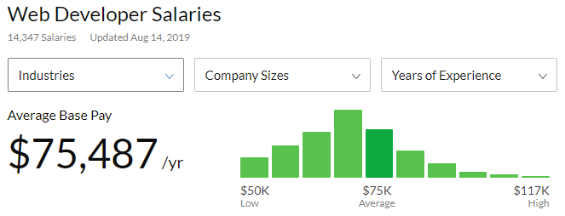
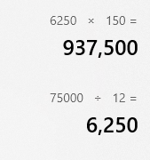
Motivation: Salary

Slide 6
World Wide Web?
“The World Wide Web is the universe of network-accessible information, an embodiment of human knowledge”. W3C
Notes:
"The World Wide Web is the universe of network-accessible information, an embodiment of human knowledge.“
Tim Berners-Lee is the inventor of the Web and the director of the W3C, the organization that oversees its development. Berners-Lee developed hypertext, the method of instant cross-referencing that supports communications on the Web, making it easy to link content on one web page to content located elsewhere. The introduction of hypertext revolutionized the way people used the internet.
It is network of online content connected through hyperlinks.

Slide 7
Web Application?
A Web application is a system (collection of web pages) that utilizes W3C standards & technologies to deliver Web-specific resources to clients (typically) through a browser. W3C
Notes:
A web application is a collection of web pages
A web page is html document having information that may be text, images, audio and video in short multi-media
A centralized information served by the distributed server to number of clients

Slide 8
Web Application Development
In early days of the WEB, web systems were built using informality, urgency, intuition and art
Notes:
Informality leads to an easy work environment—one in which you can do your own thing but planning and process framework is necessary for performing any type of work with quality.
Urgency leads to action and rapid decision making but consequences of actions must be understood at some level.
Intuition is an intangible quality that enables you to “feel” your way through complex situations but proven management and technical patterns are required.
Art leads to aesthetic form and function that pleases those who encounter it but solid design/modeling is needed for doing that.

Slide 9
Web Engineering?
“The application of systematic and quantifiable approaches (concepts, techniques and tools) to cost effective analysis, design, implementation, testing, operation, and maintenance of high-quality Web applications.” – Kappel et al
Notes:
Systematic = step wise, organized, structured, planned
Quantifiable = measurable, predictable output
Cost effective = within limits of budget, limits of effort and high quality
Analysis = requirements gathering
Design = modeling and architectures
Implementation = coding and development
Testing = validation and verification
Operation = availability
Maintenance = changes and bug fixes
Web engineering extends Software Engineering to Web applications, but with Web-centric approaches and other relevant contributions from many disciplines.
Web engineering focuses on the methodologies, techniques, and tools that are the foundation of Web application development and which support their design, development, evolution, and evaluation. Web application development has certain characteristics that make it different from traditional software, information system, or computer application development.
https://en.wikipedia.org/wiki/Web_engineering

Slide 10
Web Engineering as multidisciplinary approach?
Software process models from software engineering (depends on complexity of web application)
Requirements development and management from Software requirements engineering
Web usability such as: UI design led by UX involves HCI
Web application security and testing from information security and software testing
Web application modeling, design patterns from software design and architecture
Web application project management from Software project management
Web Development involves Web Technologies such as Client & Server side scripting languages & supporting tech:

Slide 11
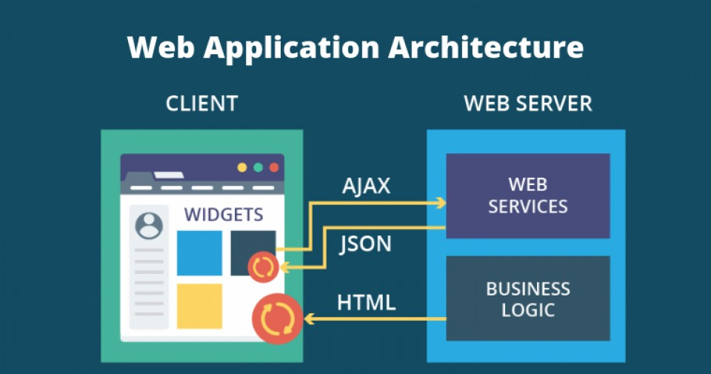
Web Applications Architecture

Slide 12
What is Web Applications Architecture?
Interactions between applications, databases, and middleware systems on the web.
It ensures that multiple applications work simultaneously
Notes:
As soon as the user hits the go button after typing a URL in the address bar of a web browser, it requests for that particular web address. The server sends files to the browser as a response to the request made. The browser then executes those files to show the requested page.
Finally, the user is able to interact with the website. The most important thing to note here is the code parsed by the web browser. A web app works in a similar way.
This code might or might not have specific instructions that tell the browser how to respond with respect to the different types of user inputs.
Hence, a web application architecture has to include all the sub-components as well as the external applications interchanges for the entire software application, in the aforementioned case, which is a website.
A web application architecture has to not only deal with efficiency, but also with reliability, scalability, security, and robustness.

Slide 13
How does it work?
With any typical web application, there are two different codes (sub-programs) running side-by-side. These are:
Client-side Code - The code that is in the browser and responds to some user input
Server-side Code - The code that is on the server and responds to the HTTP requests

Slide 14
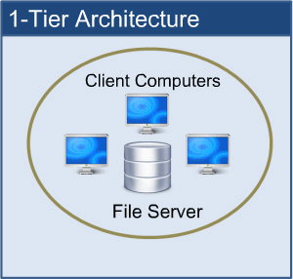
One Tier Architecture.
One-tier architecture involves putting all of the required components for a software application or technology on a single server or platform
Notes:
Basically, a one-tier architecture keeps all of the elements of an application, including the interface, Middleware and back-end data, in one place. Developers see these types of systems as the simplest and most direct way

Slide 15
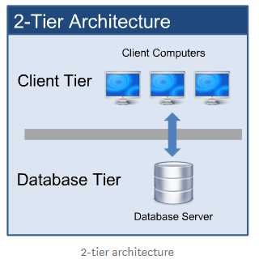
Two Tier Architecture
The two-tier is based on Client Server architecture. The two-tier architecture is like client server application

Slide 16
N-Tier Architecture
N-tier architecture would involve dividing an application into three different tiers.
These would be the
Logic tier,
The presentation tier, and
The data tier

Slide 17
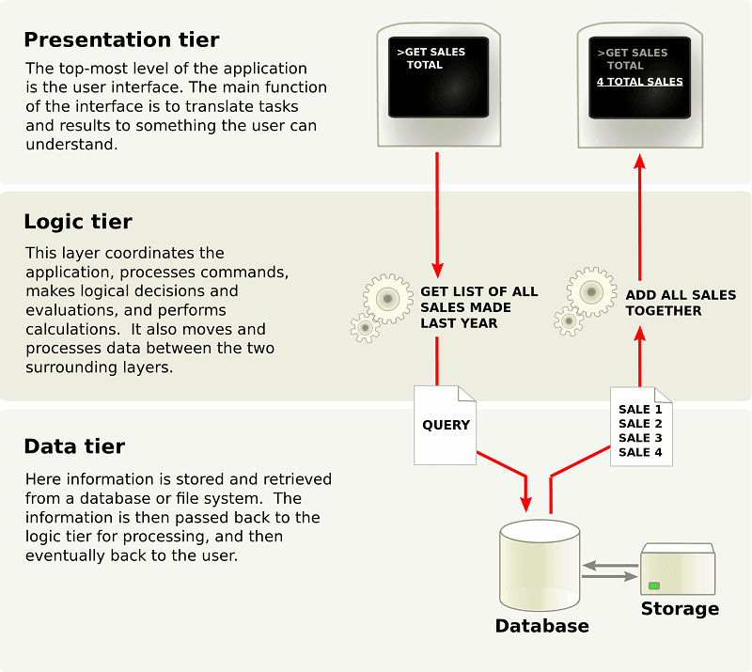
N-Tier Architecture

Slide 18
Benefits of N-Tier Architecture
Secure: You can secure each of the three tiers separately using different methods.
Easy to manage: You can manage each tier separately, adding or modifying each tier without affecting the other tiers.
Scalable: If you need to add more resources, you can do it per tier, without affecting the other tiers.
Flexible: Apart from isolated scalability, you can also expand each tier in any manner that your requirements dictate.

Slide 19
Technologies you should know!
What You Should Already Know
Before you continue you should have a basic understanding of the following:
HTML
CSS
JavaScript

